Slide 1


Slide 2
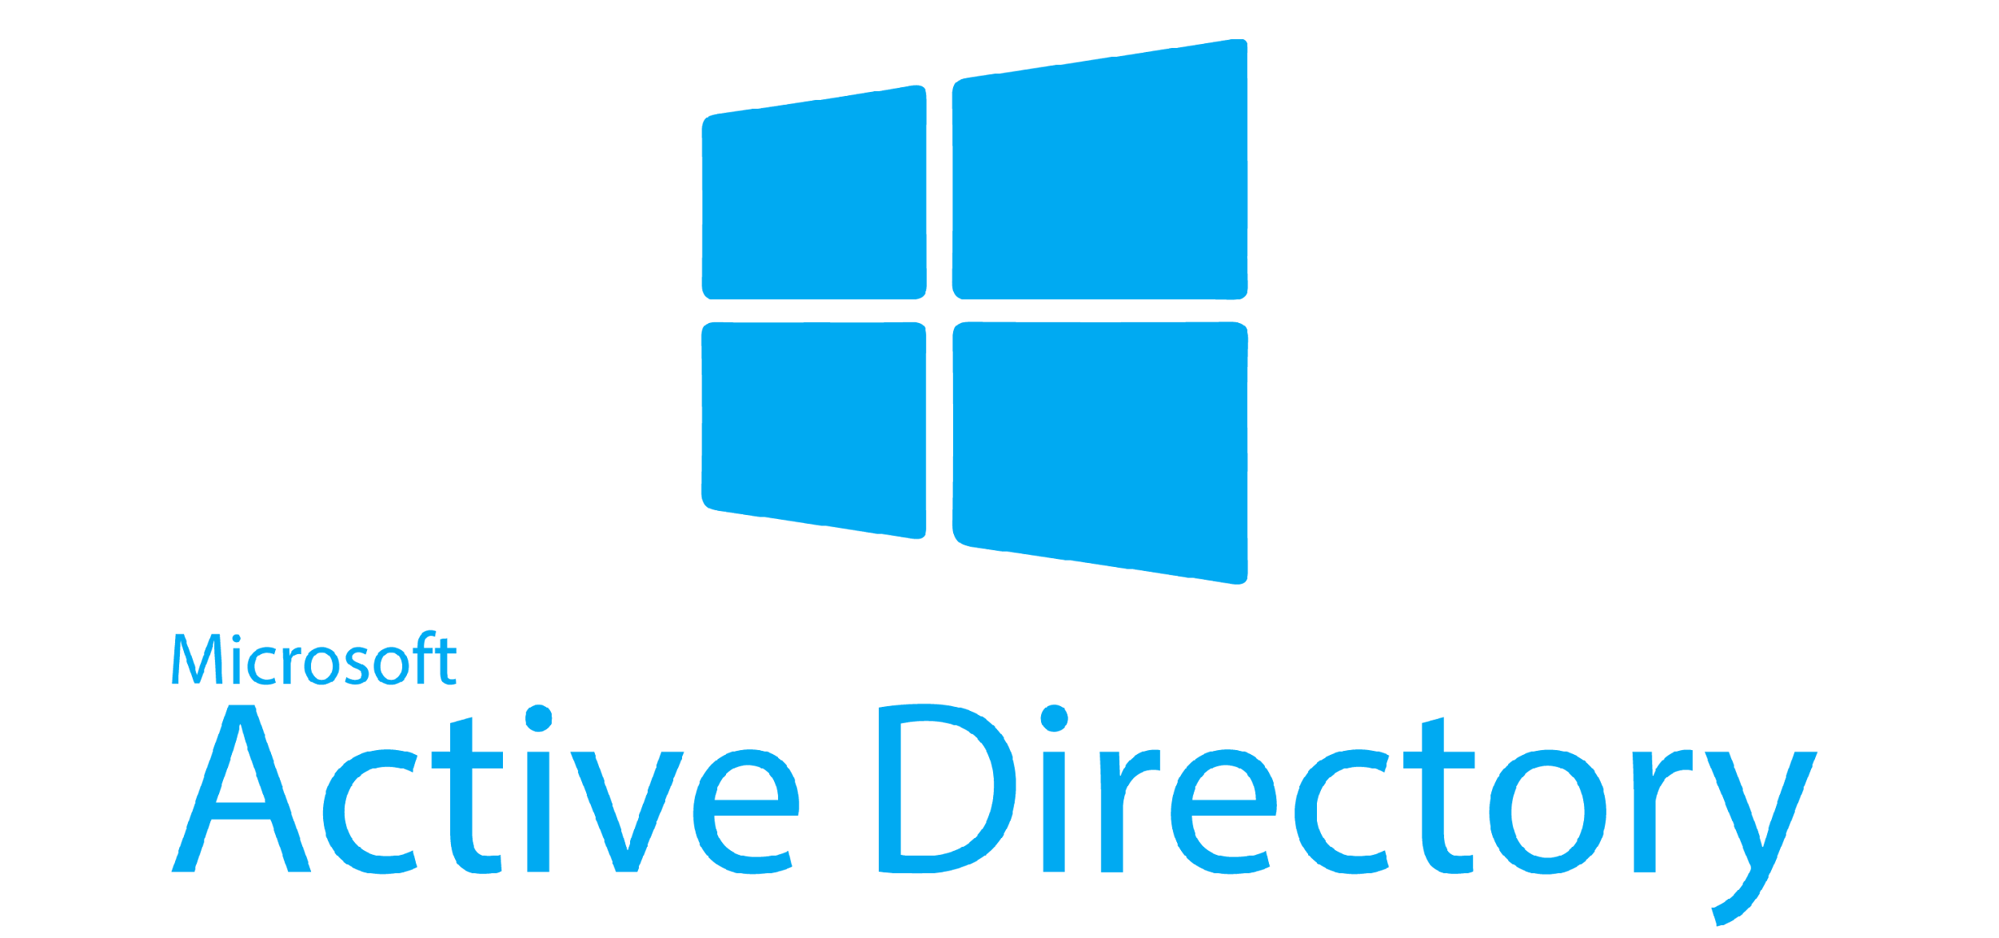

Slide 3
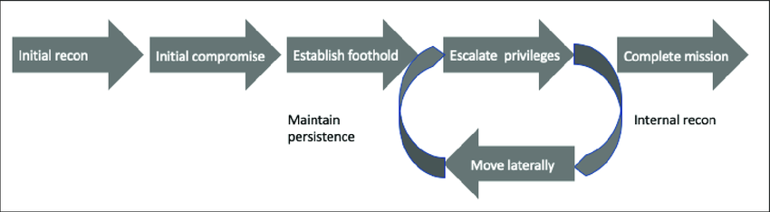
Mandiant Attack Chain

Slide 4
How it applies to AD
The whole attack chain is circular
Something you previously may not have been able to do you now might be able to do with additional access
AD is very enumeration heavy
Notes:
What I mean by circular is you need to check everything multiple times

Slide 5
Lets talk attacks
AD is very vulnerable
However, a lot of the easiest ways to attack AD are usually via misconfiguration OR overly permissive configuration.
First things first though you need to enumerate to find these issues

Slide 6
Enumeration
SMB and LDAP
SMB misconfigurations allow for a lot of data gathering
Multiple tools can be used to manually/semi manually query both SMB and LDAP for information gathering
Notes:
SMB and LDAP are the most common ways of enumerating. SMB is quite often over permissive and has more support for unauthenticated sessions than LDAP.
If

Slide 7
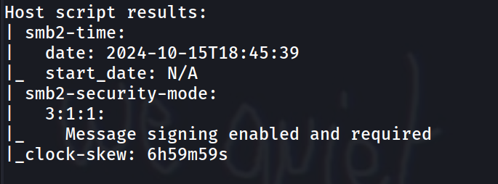
Nmap smb
Notes:
Important thing here for smb script is clock skew. When using kerberos to authenticate if the clock is too far out it breaks (will show how to fix this later)
This script is part of nmap default scripts -sC

Slide 8
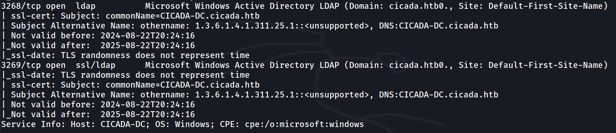
Nmap ldap
Notes:
Ldap is very leaky
As you can see in the screenshot, it has leaked the domain, the FQDN of the DC, certificate times for ldaps etc

Slide 9
NetExec
NetExec is probably the most useful tool for AD work
It’s a swiss army knife of Windows / AD hacking / enumeration
NetExec was formerly known as crackmapexec which has since been deprecated
Nxc is an abbreviation of NetExec which I will be using in all commands
Notes:
NetExec can be used to enumerate/attack:
wmi own stuff using WMI
rdp own stuff using RDP
winrm own stuff using WINRM
ldap own stuff using LDAP
ssh own stuff using SSH
mssql own stuff using MSSQL
smb own stuff using SMB
ftp own stuff using FTP
vnc own stuff using VNC

Slide 10
Alternatives for LDAP
Ldap has loads of tools. I would HIGHLY recommend using nxc but if you want to be quirky and unique:
Ldapsearch
ldeep
Ntlmrelayx
Python’s LDAP module (custom scripts)
Notes:
I’m not going to talk really on how you use these tools as I don’t personally use them that much. You can find out more on https://www.thehacker.recipes/ad/recon/ldap

Slide 11
SMB
You can use nxc to enumerate SMB as well. This is the most common method of initial enumeration of a domain controller
You can also use smbclient to directly connect to the SMB share and use it as intended
smbclient //<IP>/<share_name> -U username

Slide 12
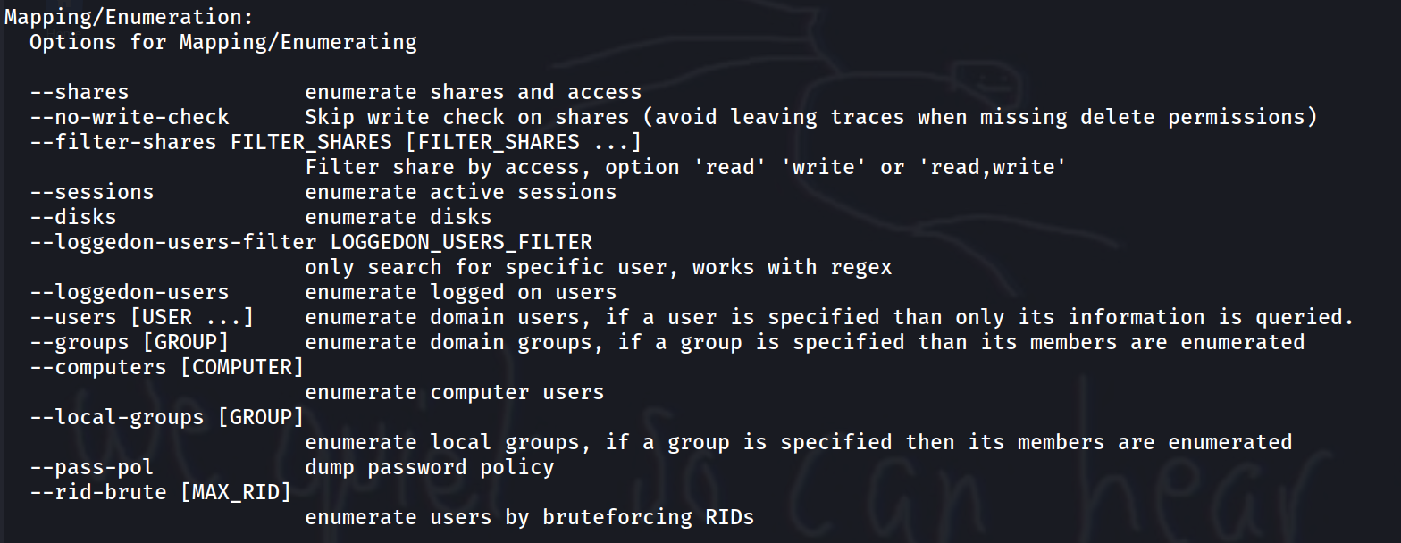
SMB
Notes:
Examples of things you can do with SMB. Some of these require a bound session to perform (i.e. valid creds) however some work with anonymous (Guest) access (such as rid-brute)

Slide 13
Things to look for (initially)
Readable file shares? - may contain user credentials
Can you enumerate users via rid-bruting (TBE) or –users?
Leaky DCs (domain name, DC name, clock skew etc)
Can you authenticate as guest?
Any user metadata (Failed login attempts, password last set, AD description field)
Notes:
A common misconception is that a users description field is private to that user. It is not, this can be queried by any domain user
Clock skew can be fixed using ntpdate
sudo ntpdate -d <DC>

Slide 14
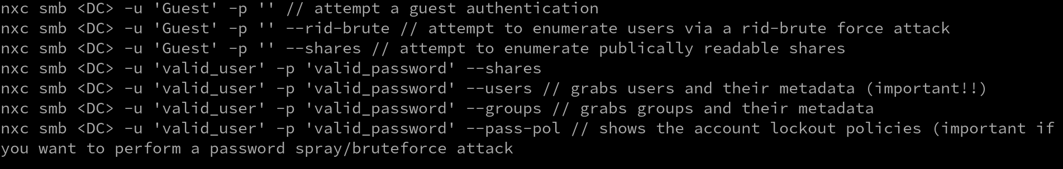
Some useful nxc commands

Slide 15
rid-bruting
Every user/group in AD has a SID (Security Identifier)
Looks a bit like this:
S-1-5-21-1180699209-877415012-3182924384-1004

Slide 16
Breakdown of a SID
S-1-5-21-1180699209-877415012-3182924384-1004
S - Indicates it is a SID
1 - SID version identification number
5 - Identifier Authority
21-1180699209-877415012-3182924384 - Domain or Computer identifier
1004 - RID (Relative ID)

Slide 17
rid-bruting
Each account / group has a unique SID and RID (sorta)
RIDs are sequential and some are static. For example:
Administrator will always have a RID of 500
As RIDs are sequential, these can be bruteforced to identify valid accounts / groups!

Slide 18

Rid-bruting conditions
You must have read access to IPC$ (SMB Share)
You must be able to authenticate as Guest (at bare minimum)
You must be able to interact with RPC (can test with rpcclient if you wish)
Easiest way to check if you can rid-brute is just attempt it
This will give you an output of usernames that you can then use to perform further enumeration attacks

Slide 19
Bloodhound
Bloodhound is amazing
It does a load of enumeration for you and puts it in graphical format to make it easy for you to analyse
The issue? You need to run a bloodhound collector which either means you need terminal access to a domain joined machine OR valid domain credentials
Notes:
(side note, bloodhound is not required for todays practical, if you want to use it for practice sake

Slide 20

Bloodhound vs Sharphound
There is a (semi) important distinction
Bloodhound is the GUI that you use for analysis
Sharphound is the collector*
Don’t get them mixed up!
* you also have bloodhound-python which is the linux based injector that you need domain creds for, sharphound is all windows based

Slide 21
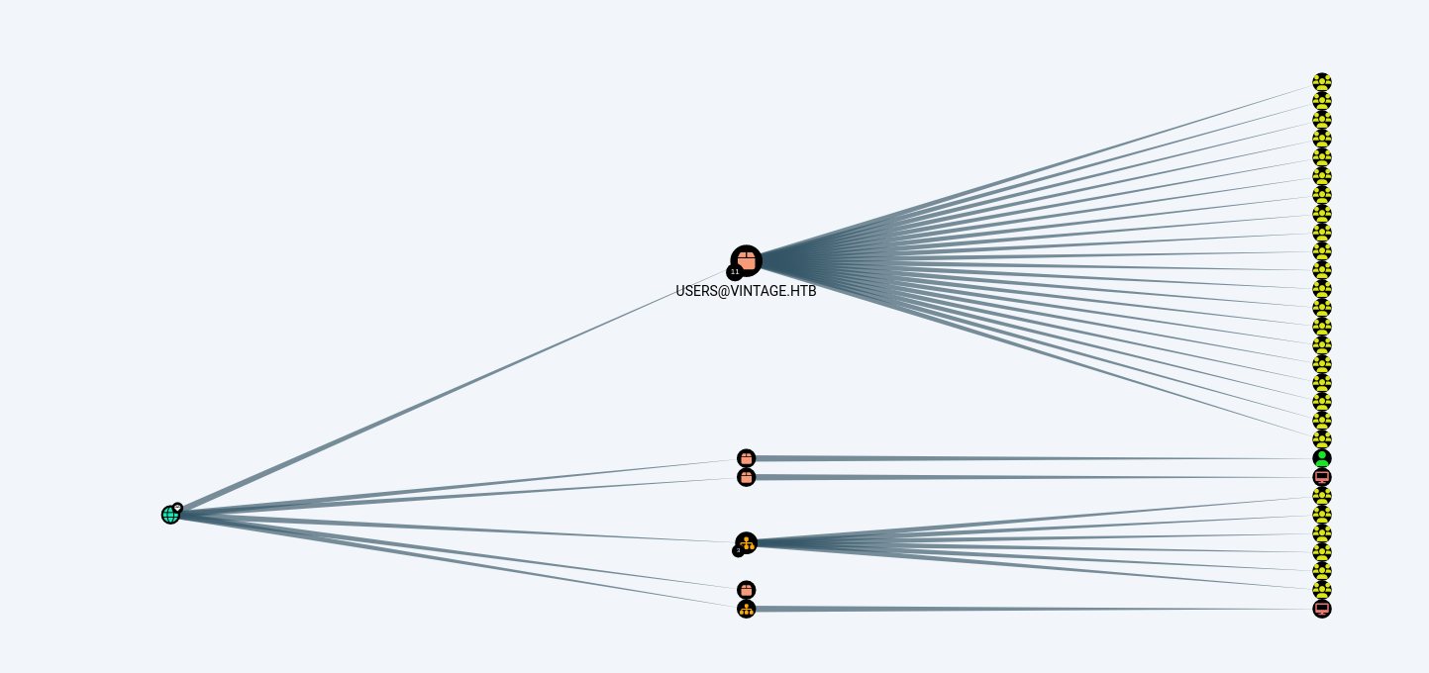
Bloodhound screenshot

Slide 22
Attacks / Exploitation
Too many to count so we’ll go over the highlights
Most of the commands / attacks we’re looking at here can be found on https://thehacker.recipes/ it’s an amazing resource, please use it.

Slide 23

ASREPRoasting
Exploits an issue with Kerberos pre-authentication (don’t worry too much how this works, idk either)
Allows you to steal an encrypted response to an account with pre-authentication disabled. The response is encrypted with the accounts password hash therefore you can attempt to crack the hash by using tools such as hashcat.
You can use Impacket to perform this attack
Notes:
Note you cannot perform a pass the hash attack with the details from ASREProasting, only crack the password hash itself
Important side note. Any screenshot of an impacket attack where the script ends in .py is only if you are using the example scripts from impackets github. If you are using the kali version it is in the format Impacket-<attack>, as an example impacket-GetNPUsers

Slide 24
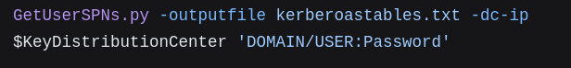
Kerberoasting
Similar to ASREPRoasting except exploits an issue with Service Principal Names (SPNs)
SPNs are set on accounts that perform a service such as a sql server account (known as service accounts)
They are commonly prefixed or suffixed with svc
To perform a Kerberoast you need a authenticated session so Kerberoasting is good for lateral movement
Kerberoasting can also be performed with Impacket

Slide 25

Pass-The-Hash
Briefly mentioned last week, you can authenticate with just a users hash rather than needing to know the password. This is due to the way the challenge system works with NTLM authentication.
Most tools such as nxc and evil-winrm come with PTH options.

Slide 26
Pass-The-Ticket / Pass-The-Cache
Pass the ticket is when a cached or forged Kerberos ticket is used to authenticate with services
Cached tickets can be found in things such as LSASS which can be dumped using tools like Mimikatz
Pass-The-Cache is the same attack but using the UNIX style ccache files instead of windows style tickets

Slide 27
LSASS
The LSASS service contains live credentials and tickets for users authenticated with the system. These cannot be remotely dumped therefore you will need a foothold on the machine to do this. There are easier ways of stealing creds if you have high enough privileges to do so.
LSASS dumping is more useful in a real life scenario than CTFs.
Notes:
For example, say a domain administrator is logged into a RDP session on a machine. If an attacker manages to dump LSASS (you need local admin perms for this) then they will be able to steal the domain admins ticket and perform a pass the ticket attack using this stolen ticket.

Slide 28
SAM and LSA dumping
SAM, SYSTEM, SECURITY
Registry keys (HKLM\SAM, HKLM\SYSTEM, HKLM\SECURITY
SAM contains locally cached credentials (known as SAM Secrets)
SECURITY contains domain cached credentials (LSA Secrets)
SYSTEM contains enough information to decrypt SAM and LSA secrets
In order to steal these secrets different levels of permissions are needed
To steal SAM/LSA secrets you need SeBackupPrivilege or be an administrator.
Notes:
LSA

Slide 29
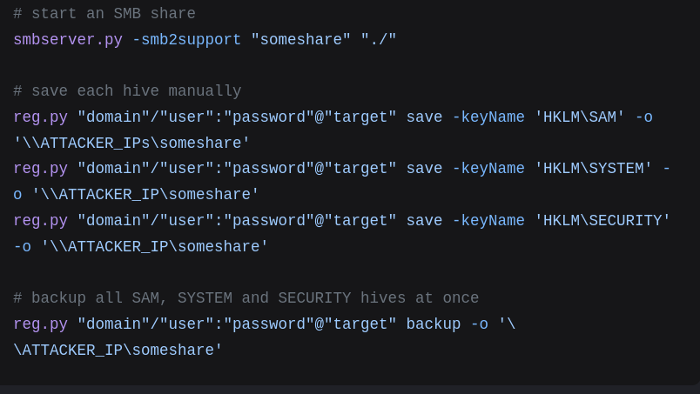
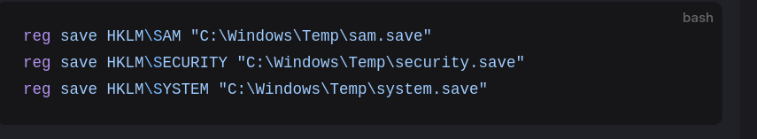
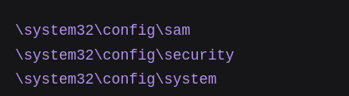
SAM and LSA dumping
Live Windows (running)
Remotely using impacket
Offline Windows
Notes:
When windows is running the SAM, SECURITY, SYSTEM files are all mounted and cannot be copied. When offline the files can be copied like any other file

Slide 30
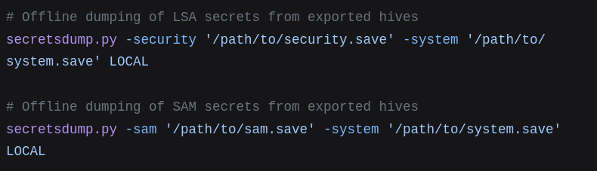
Extracting Hashes from dumps
Notes:
Other tools can do this as well as impacket, feel free to have a google around (alternatives also on thehacker.recipes)

Slide 31
Other things you can dump
DPAPI Secrets
NTDS Secrets
LSASS
Browser Creds
Windows Credential Manager
Not going to go over all of these as you can read up on them yourselves later
Notes:
DPAPI is like Microsofts password manager. Can contain credentials etc.
NTDS - NTDS.dit file on Domain Controllers stores all password hashes for the domain. Every user.
LSASS - already spoken about
Browser Creds - unlikely to find on a DC unless you are in a really unsanitary domain
WCM - could have something cool in there

Slide 32
DCSync
The god mode attack
If you can perform this you have essentially got full domain control
DCSync is simulating the process of DC replication
It allows the stealing of the krbtgt account hash which allows you to forge kerberos tickets (Golden Ticket attack) which you can then pass the ticket with.
To perform this you need valid credentials for an account with “DS-Replication-Get-Changes” and “DS-Replication-Get-Changes-All” set. You can find these from bloodhound data or manual enumeration
Notes:
Allows the replication of NTDS.dit

Slide 33
LLMNR Poisoning (another way to steal a hash)
Link Local Multicast Name Resolution protocol
Based on DNS
LLMNR Poisoning is a type of MITM attack that exploits machines that do not require SMB signing
A few tools need to be chained together to do this

Slide 34
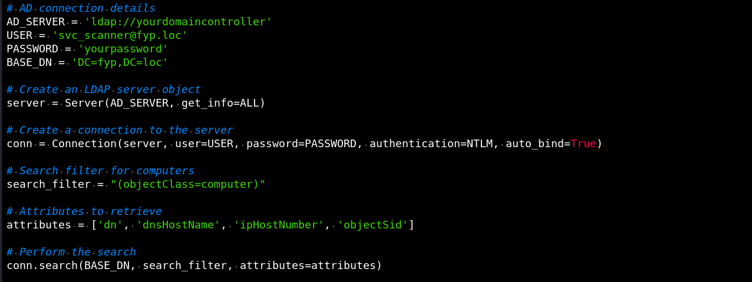

Step 1 - Get vulnerable targets
Notes:
Partial python script to get all AD computers
Netexec command to

Slide 35


Step 2 - Setup relay and responder

Slide 36
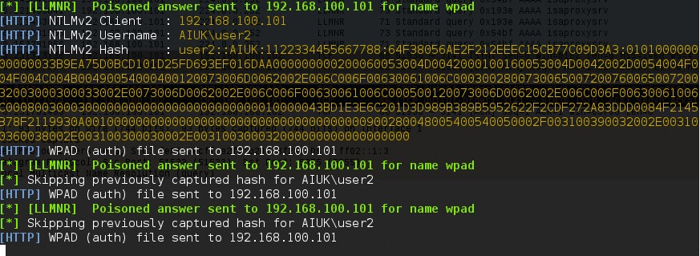
Step 3 - Wait for hashes to come in

Slide 37
Bruteforcing
Three main types:
Guessing
Spraying
Stuffing
Notes:
Password guessing - trying basic passwords, default passwords etc
Password Spraying - using a single password against a multitude of accounts. For example if a company has a default password (Winter2025 for example) this may catch out some people who don’t change it
Password Stuffing - Very similar to spraying and guessing. It is looking for reuse of cracked / stolen creds

Slide 38
ADCS
Security Engineers nightmare, pentesters dream
ADCS is Active Directory Certificate Services
Can be used for signing, authentication, encrypting systems etc
Not a default part of AD, however many large orgs use it
Probably one of the easiest ways to get DA if misconfigured
Certify (certipy-ad on kali) is the swiss army knife of ADCS

Slide 39

Connecting to a Windows Machine
WinRM - Windows remote Management (Port: 5985/5986)
RDP - Remote Desktop Protocol (Port: 3389)
Tools on kali for this:
xfreerdp or rdesktop - RDP
evil-winrm - WinRM ← Use this in most CTFs. RDP is usually closed
Notes:
It is always good when you get creds to test with Evil-WinRM to see if you can authenticate. Having keyboard access opens up the ability to use further tools that are windows based rather than linux based

Slide 40
This isn’t even the half of it
The topic of AD is huge. There are a lot of attacks not covered here including nearly every persistence method.
These are some of the basic attacks you can perform. Everything you will need for todays practical has been in these slides. I would also recommend referring to thehacker.recipes while doing the practical.

Slide 41
Practical Task
https://app.hackthebox.com/machines/Cicada
Have a go using the Guided Mode. If you have any question follow these 3 steps:
Check the powerpoint, everything you need is on here
Google what you’re trying to do
Ask a committee member (myself and adam have completed this machine recently)

Slide 42
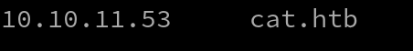
Setting up hosts
In order to query AD as it is DNS heavy you will need to configure your hosts file. Follow these steps
Perform an nmap scan on the IP address of the machine to find the domain name
run sudo nano /etc/hosts and create an entry so it looks like the image
Save and exit
The gap is 1 Tab

Slide 43
Resources
https://www.thehacker.recipes/
https://book.hacktricks.wiki/en/index.html
https://github.com/infosecn1nja/AD-Attack-Defense

